Slide 1
Programiranje I – RIN
Računalništvo I – MA
Tree
7th lecture

Slide 2
Overview
The tree data structure is non-linear;
A node may have several successors, but at most one ancestor;
For example, two forms of family tree:
Descendants tree:
Jure
Ancestor tree:
Tine
Tone
Miha
Darja
Tone
Marta
Peter
Pavel
Vid
Meta
Tanja
Ivo
Peter
Tončka
Lojze
Meta
Peter
Nada
7th lecture
Programiranje I / Računalništvo I
© Branko Kavšek, Jernej Vičič
slide <number>

Slide 3
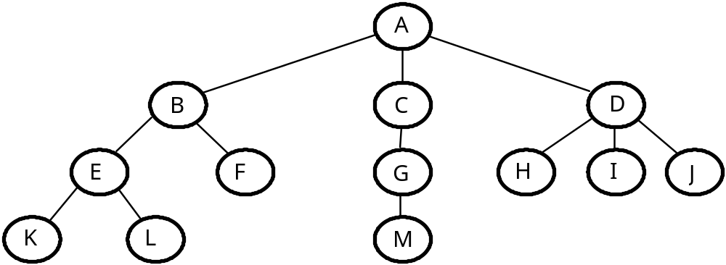
Predstavitev dreves
Običajni grafični zapis in predstava:
Drevo stoji “na glavi” oz. rišemo njegove “korenine”
7th lecture
Programiranje I / Računalništvo I
© Branko Kavšek, Jernej Vičič
slide <number>

Slide 4
Terminology
Node: element of a tree; it has some data and information about the subtrees.
Leaves (terminal nodes): nodes without descendants.
Root: the top node, node without a predecessor.
Internal node: every node except leaves.
Offspring(or descendant): root node of a subtree, v :: = sin (v);
Father (or predecessor): the v:: = father (v);
Siblings: root subtree of the same node, the node with the same father
Ancestors: each node on the path from the root to a node;
7th lecture
Programiranje I / Računalništvo I
© Branko Kavšek, Jernej Vičič
slide <number>

Slide 5
Node
All "circles". The nodes store data and maintain the structure.
Nodes: A, B, C, D, ...
7th lecture
Programiranje I / Računalništvo I
© Branko Kavšek, Jernej Vičič
slide <number>

Slide 6
Leaves / root
Leaves (terminal nodes): nodes without descendants
Root: the top node, node without a predecessor.
Leaves: K, L, F, M, H, I in J
Root: A
7th lecture
Programiranje I / Računalništvo I
© Branko Kavšek, Jernej Vičič
slide <number>

Slide 7
Offspring (sin) / father (oče)
Node B is the son of node A and father of nodes E and F.
Node A does not have a father (it is the root) and it has offsprings B, C and D.
7th lecture
Programiranje I / Računalništvo I
© Branko Kavšek, Jernej Vičič
slide <number>

Slide 8
Siblings (Bratje), ancestors (predniki)
Nodes B, C and D are siblings (their father is A)
Predecessors of the node L are E, B and A.
7th lecture
Programiranje I / Računalništvo I
© Branko Kavšek, Jernej Vičič
slide <number>

Slide 9
Concepts
Subtree: the entire tree, starting from node.
Node degree: given by the number of subtrees (the number of direct successors);
Degree of the tree: the highest degree of its nodes.
Level (depth) of a node: root is on level (depth) 1. If a father is on depth n, the son is on n +1.
Height of the tree: defined by the node with the highest level.
Forest: a set of disjoint trees.
Ordered tree: the order of subtree at each node is given and is important.
7th lecture
Programiranje I / Računalništvo I
© Branko Kavšek, Jernej Vičič
slide <number>

Slide 10
Subtree
Subtrees of the node A
B
C
D
E
F
G
H
I
J
K
L
M
Subtrees of the node D
Subtrees of the node B
E
F
H
I
J
K
L
7th lecture
Programiranje I / Računalništvo I
© Branko Kavšek, Jernej Vičič
slide <number>

Slide 11
Degree of a node/ degree of the tree
Node A has degree 3
Node K has degree 0 (all leaves have degree 0)
Node C has degree 1
Tree has degree 3 (max degree of the nodes is 3) – triplet tree
7th lecture
Programiranje I / Računalništvo I
© Branko Kavšek, Jernej Vičič
slide <number>

Slide 12
Level (depth) of a node / height of the tree
Node A is at depth 1 (only root is at depth 1).
Node K is at depth 4.
Node C is at depth 2.
The height of the tree is 4.
7th lecture
Programiranje I / Računalništvo I
© Branko Kavšek, Jernej Vičič
slide <number>

Slide 13
Forest
B
D
E
F
C
H
I
J
K
L
G
M
7th lecture
Programiranje I / Računalništvo I
© Branko Kavšek, Jernej Vičič
slide <number>

Slide 14
About trees
Definitions:
  http://en.wikipedia.org/wiki/Tree_%28data_structure%29
7th lecture
Programiranje I / Računalništvo I
© Branko Kavšek, Jernej Vičič
slide <number>

Slide 15
Types of trees
Binary trees
  Ancestor tree
  A tree of an arithmetic expression
2-3 tree
AVL tree
B-tree
Left-most tree
...
7th lecture
Programiranje I / Računalništvo I
© Branko Kavšek, Jernej Vičič
slide <number>

Slide 16
Binary tree
Ordered tree.
Degree of all nodes is at most two.
Definition:
  binary tree is either empty or it consists of special root node, which has a left and right subtree;
  left and right subtree are again binary trees.
7th lecture
Programiranje I / Računalništvo I
© Branko Kavšek, Jernej Vičič
slide <number>

Slide 17
Binary tree
Definition:
  binary tree is either empty or it consists of special root node, which has a left and right subtree;
  left and right subtree are again binary trees.
7th lecture
Programiranje I / Računalništvo I
© Branko Kavšek, Jernej Vičič
slide <number>

Slide 18
Data structure binary tree
structure BINARY TREE
declare
prepare: 0 → binary tree;
compose: (binary tree, data, binary tree) → binary tree;
return: binary tree → data;
left subtree: binary tree → binary tree;
right subtree: binary tree → binary tree;
empty: binary tree → {true, false};
7th lecture
Programiranje I / Računalništvo I
© Branko Kavšek, Jernej Vičič
slide <number>

Slide 19
Data structure binary tree
where
left subtree (prepare) ::= ERROR;
left subtree(compose(l,k,d)) ::= l;
right subtree(prepare) ::= ERROR;
right subtree(compose(l,k,d)) ::= d;
empty(prepare) ::= true;
empty(compose(l,k,d)) ::= false;
return(prepare) ::= ERROR;
return(compose(l,k,d)) ::= k;
end;
7th lecture
Programiranje I / Računalništvo I
© Branko Kavšek, Jernej Vičič
slide <number>

Slide 20
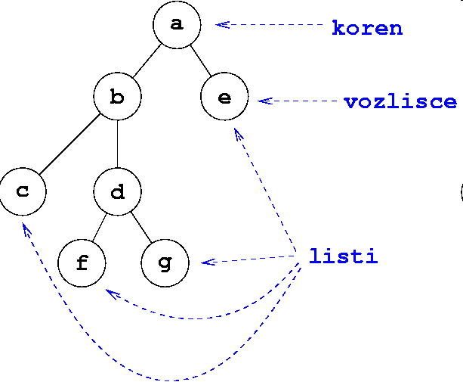
Tasks
Mirror copy
Count leaves
Average tree
7th lecture
Programiranje I / Računalništvo I
© Branko Kavšek, Jernej Vičič
slide <number>

Slide 21
Special forms of binary trees
Degenerated binary tree
Left-most binary tree
A
A
B
B
C
C
D
E
F
G
D
H
I
7th lecture
Programiranje I / Računalništvo I
© Branko Kavšek, Jernej Vičič
slide <number>

Slide 22
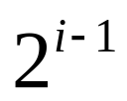
Binary tree properties
Maximum number of leaves at level (depth)i:
A
example.:
B
C
Level = 3
Nimber of nodes = 2 ³⁻¹
D
E
F
G
7th lecture
Programiranje I / Računalništvo I
© Branko Kavšek, Jernej Vičič
slide <number>

Slide 23
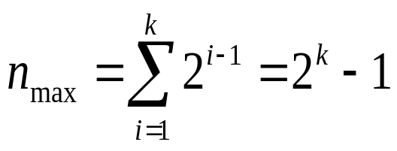

Binary tree properties
Maximum number of nodes in a tree of height k:
Smalles height of a tree with n nodes:
7th lecture
Programiranje I / Računalništvo I
© Branko Kavšek, Jernej Vičič
slide <number>

Slide 24
Predstavitev dvojiških dreves
Using pointers
  (data, pointer to father)
  (data, pointer to left and right offspring)
  (data, pointer to father, pointer to left and right offspring)
  Depends on usage
array
  Forget about index.
  Sort items by levels.
  At the same level from left to right.
  Example:
    left offspring(i) = 2i, if i has a left offspring, else undef
    right offspring(i) = 2i + 1, if i has a right offspring, else undef
7th lecture
Programiranje I / Računalništvo I
© Branko Kavšek, Jernej Vičič
slide <number>

Slide 25
Static presentation of a tree
With linear array: favorable, if the tree is full or left aligned HOW DO WE MAINTAIN THE STRUCTURE?
Elements are entered into the table starting with the root node by levels; blanks are specially marked;
If the tree is not full, we need for each node to release vacant empty space into a vector to keep indexing .
Nodes in the array:
A
A
B
C
D
E
F
G
B
C
Rules:
Father(i):=i % 2 (or none)
Left_offspring:=father*2 (or none)
Right_offspring:=father*2+1(or none)
D
E
F
G
7th lecture
Programiranje I / Računalništvo I
© Branko Kavšek, Jernej Vičič
slide <number>

Slide 26
Presentation of binary trees
int[] drevo = new int[100];
d[1] := 10; d[2] := 12; d[3] := 31; d[4] := 4;
d[5] := 0; d[6] := 51; d[7] := 16; d[8] := 71;
d[9] := 8; d[10] := 0; d[11] := 0; d[12] := 0;
d[13] := 9; d[14] := 10; d[15] := 0
7th lecture
Programiranje I / Računalništvo I
© Branko Kavšek, Jernej Vičič
slide <number>

Slide 27
Bad case: degenerated tree
In poorly occupied or even degenerated tree we deal with great loss of space. "Holes" that are high in a tree, cause significant loss because all their successors are missing at lower levels (two positions at the level of the hole, four on the next, etc.).
A
Presentation of the vector in static presentation:
B
A
-
B
-
-
-
C
-
-
-
-
-
-
D
C
D
7th lecture
Programiranje I / Računalništvo I
© Branko Kavšek, Jernej Vičič
slide <number>

Slide 28
Presentation with pointers
(kazalci, referencami)
Ussually:
  Pointer to left offspring
  Data
  Pointer to right offspring
7th lecture
Programiranje I / Računalništvo I
© Branko Kavšek, Jernej Vičič
slide <number>

Slide 29
Dinamic tree presentation
pod.
L
D
pod.
pod.
L
D
L
D
pod.
pod.
pod.
L
D
L
D
L
D
7th lecture
Programiranje I / Računalništvo I
© Branko Kavšek, Jernej Vičič
slide <number>

Slide 30
Search tree
contains data arranged in by one key;
each node: each element in the set of data in the left subtree is not larger than and each element in the set of data in the right subtree in not smaller than the data in the root
binary search tree or binary dictionary
7th lecture
Programiranje I / Računalništvo I
© Branko Kavšek, Jernej Vičič
slide <number>

Slide 31
Search tree
Binary dictionary:
  description of the process
7th lecture
Programiranje I / Računalništvo I
© Branko Kavšek, Jernej Vičič
slide <number>

Slide 32
Example:
25
12
30
7
18
26
32
28
5
9
15
27
7th lecture
Programiranje I / Računalništvo I
© Branko Kavšek, Jernej Vičič
slide <number>

Slide 33
Vzdrževanje urejenih podatkov v seznamu in v iskalnem drevesu
število primerjav in premikov, potrebnih, da pregledamo iskalno drevo, je enako višini drevesa; rast višine drevesa s številom podatkov je počasna, posebej za velike n;
višina polnega drevesa z n podatki je proporcionalna log(n);
če v iskalno drevo vstavljamo že urejeno zaporedje podatkov, dobimo izrojeno drevo - seznam;
višina izrojenega drevesa z n vozlišči je n.
7th lecture
Programiranje I / Računalništvo I
© Branko Kavšek, Jernej Vičič
slide <number>

Slide 34

Comparison
Height of the tree
Degenerated tree - list
Full tree
Number of nodes
The expected height of search tree is in the dashed area. We want to be close to the bottom curve.
Advantage of maintaining data in the tree increases with more data. Twice as much data increases its height (full tree) by 1 (number of necessary comparisons and movements).
7th lecture
Programiranje I / Računalništvo I
© Branko Kavšek, Jernej Vičič
slide <number>

Slide 35
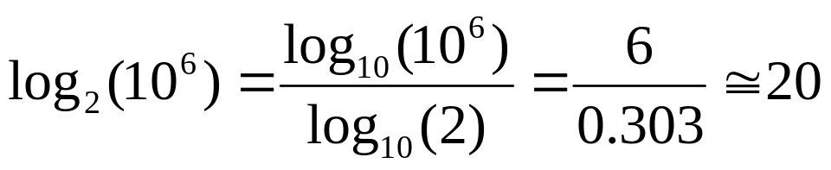
Example:
Search data in list with 10⁶ elements: worst case 10⁶ comparisons and moves.
Search data in full binary tree with 10⁶ elements: worst case:
comparisons.
Search in a tree with 2*10⁶ data needs only one more comparison.
7th lecture
Programiranje I / Računalništvo I
© Branko Kavšek, Jernej Vičič
slide <number>

Slide 36
Insert
Same as search
7th lecture
Programiranje I / Računalništvo I
© Branko Kavšek, Jernej Vičič
slide <number>

